Slide 1
Homework 1
The second homework consist in the visualization of a 4 Degrees-of-Freedom (DoF) robot manipulator in the rviz2 simulation environment and also in the gazebo one.
Rviz2 is a 3D visualization environment, in which we can visualize first of all the robot itself, obviously, but also we can subscribe to the ros2 topics so we can visualize it informations, such as sensors data, like the images from a camera sensor, or clouds of points generated by the LiDAR sensor. So rviz2 is very useful for debugging for example, because we can visualize most likely in real-time all the informations that we need to understand what’s happening in our scenario.
A lack of rviz2 is the fact that the physics isn’t simulated, so in this environment we don’t have factors like the gravity, the friction and so on, like the impacts of the robot with some obstacle and so the consequent reaction inpact ect.
We can compensate this lack with the Gazebo simulator, in which we can model also a real world environment to study more realistically how the robot will interact with a real life scenario.

Slide 2
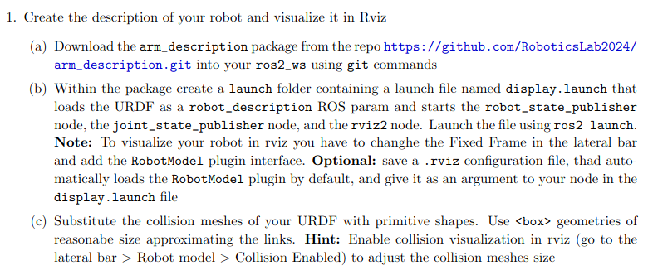
Homework 1
The tasks of the first point of the HM1 are the following:

Slide 3
Homework 1
Once downloaded the package from github, we can see that it contains 4 files:
A CMakeList.txt file, which is used for the managing of the compilation process of a software project, it contains the needed dependencies (also the order of they is important in some cases), the refs to the libraries and so on;
A package.xml file which is a tipical file of ros1 and ros2, by which we can specify the dependencies, but differently from a cmakelist file, the informations that it specifies are more for the human than for the machine. For example, we specify some data like the name of the project, the version, the supervisor and so on;
A mesh folder which contains all the meshes used for the visualization of our robot. A mesh is a representation of a 3D object, and it’s composed by many polygons, like triangles, connected by dots. It’s also used for the FEM analisys for example;
And then there is a urdf folder with the homonymous file. The urdf is a .xml file which is used in ros for the physical description of robots, like the cinematic chain, so the description of links (by the meshes for example), and the joints used. We can also specify the mass of the elements and other things that we will see afterwards.

Slide 4
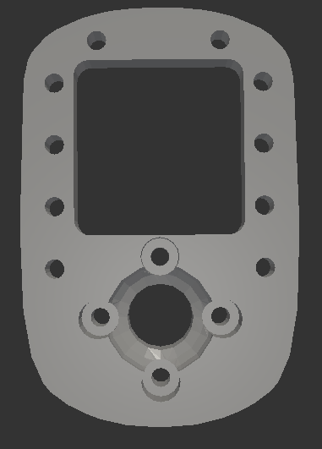
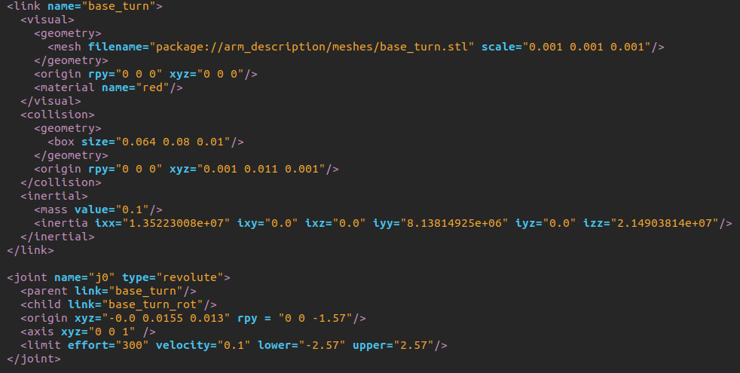
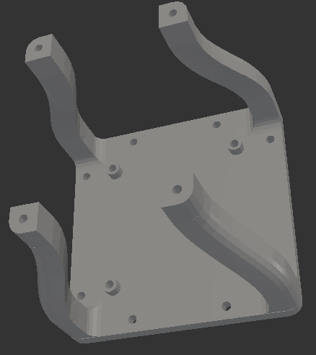
Homework 1

Slide 5
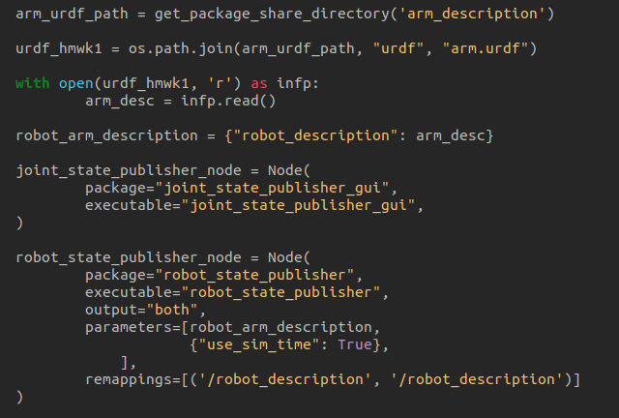
Homework 1
The second task of the first point asks to write a launch file, with which we have to retrieve the robot description via the urdf file, then we use this information to send Transormation Frames (TF’s), via the robot state publisher topic, so that we can visualize the robot configuration, in this case in rviz2. Apart the robot state publisher, we have to start the joint state publisher, which is used for the hononymous task. The two publishers are different, because one sends data about the TF and the other sends the joint states, so for example an angle for the rotational joint or a displacement for a prismatic joint. All of this things are done here:

Slide 6
Homework 1
We can also notice that one of the parameters in the creation of the robot state publisher, is the “use_sim_time”, and it’s set to true. That means that we’re refering to the simulation time and not the real one. This is useful because every component of our project will be syncronised to one time reference, and not the real one, because in that case we could have some delays for example.

Slide 7
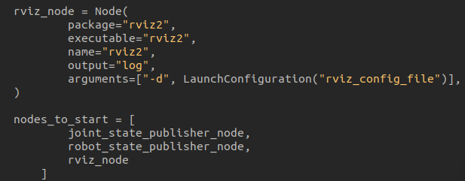
Homework 1
But we also need to start the rviz2 simulation environment, so that we can retrive all the data that we are going to send on the topics and visualize it. Here it is shown how i did that:
We can also notice that we’re using come rviz_config_file, it’s about the optional task specified in the b) point. In pratically the config file is used to set what are the topics that we want to listen, so that at the start of the simulation we can immediately visualize what we want, without the need to specify it everytime.

Slide 8
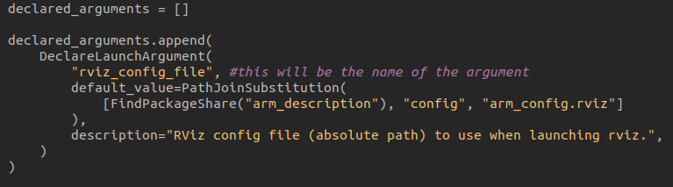
Homework 1
Here we specify where to find and take the rviz config file:

Slide 9
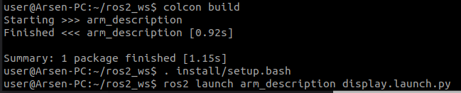
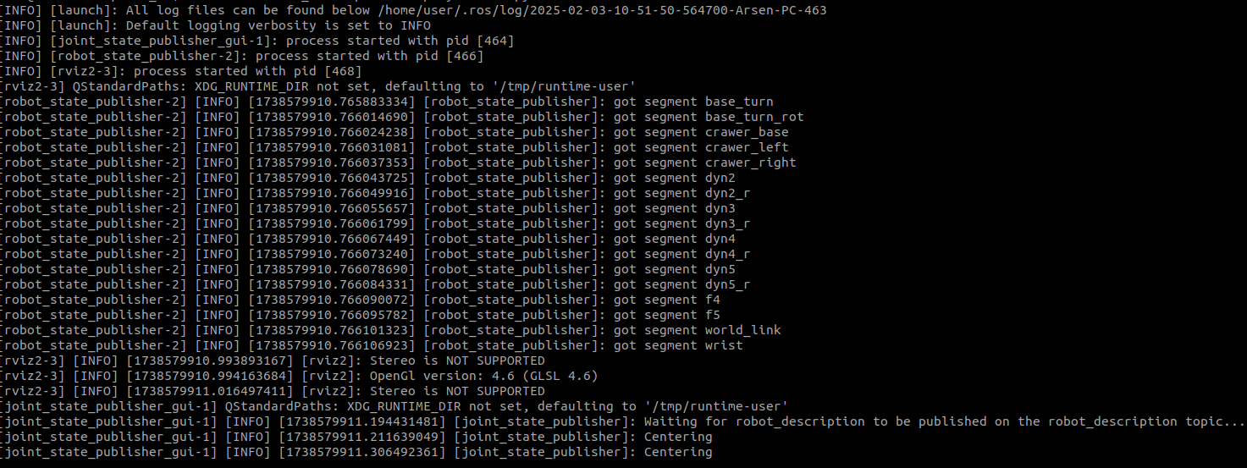
Homework 1
Here it’s shown the building of the package and the launch of our simulation:

Slide 10
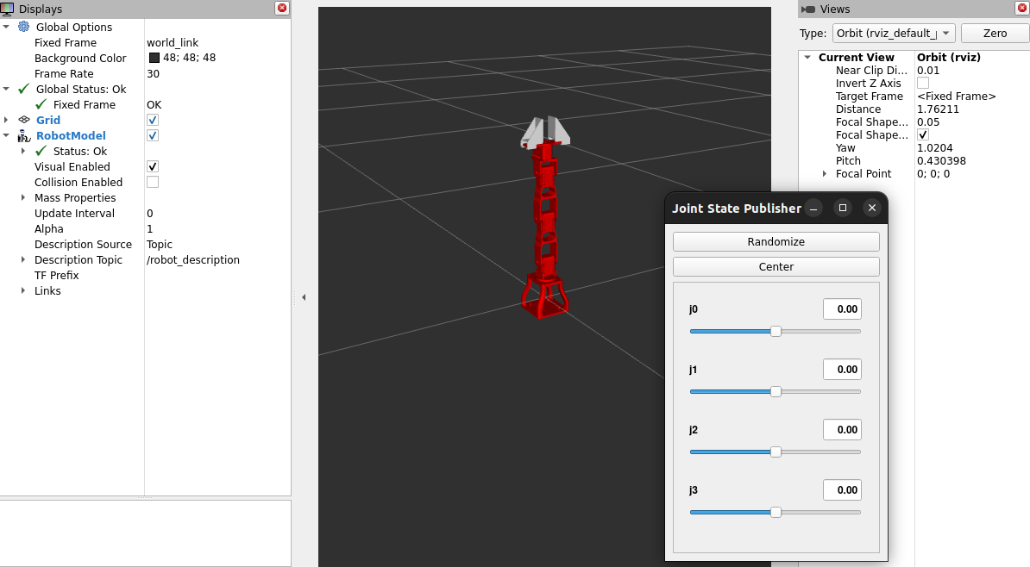
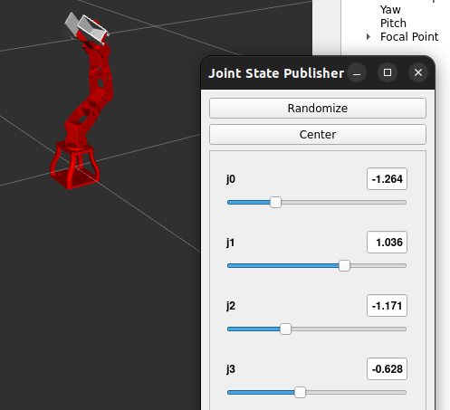
Homework 1
And here we can see the robot spawned in the rviz2 environmet, also with the possibility to change the joints state via the interface, we can notice that the robot doesn’t fall, it should have to because there isn’t a control system, even just for the gravity compensation, but in rviz2 the gravity isn’t simulated.

Slide 11
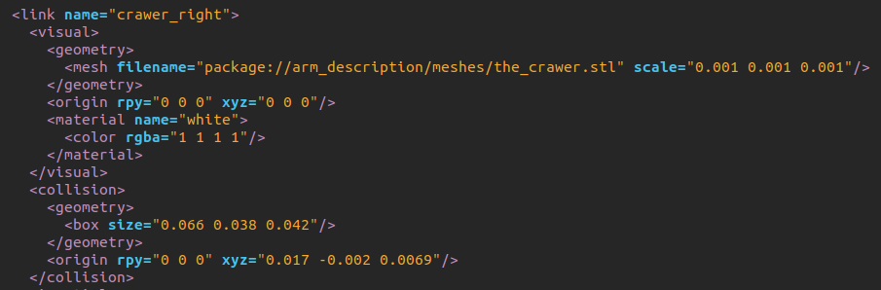
Homework 1
The last task for the first point consist in substituting the collision meshes with primitive shapes, so that the calculation of an eventual contact of the robot with the environment is simpler than consider the real form via meshes:
Here it’s shown that for the visualization we still use meshes, but for the collision we use box shapes.

Slide 12
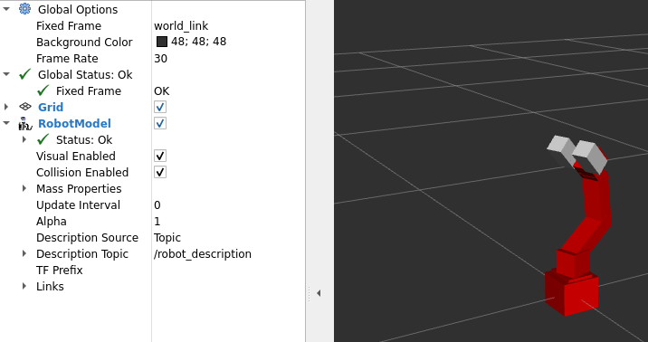
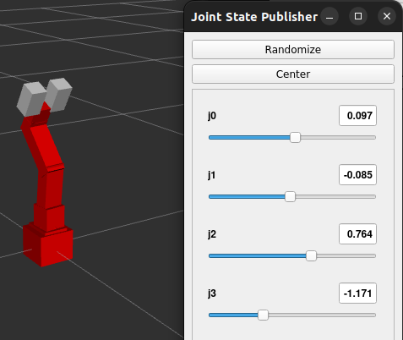
Homework 1
And here is the results of the collision shapes modelling, we can see that the collision shapes move correctly in function of the robot’s configuration:

Slide 13
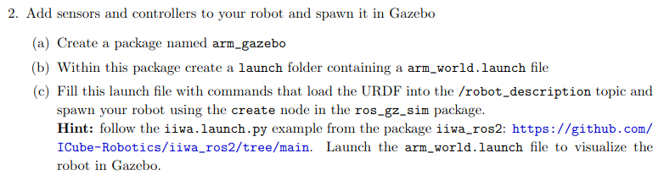
Homework 1
The second point of the HW1 starts with these tasks:
So practically we have to start the simulation in gazebo and visualize the robot in this other environment. The result of those operations will be, obviously the robot spawning in the environment, but it will fall down because at this point we haven’t implemented the controllers yet (but the gravity in this case is present as well).

Slide 14
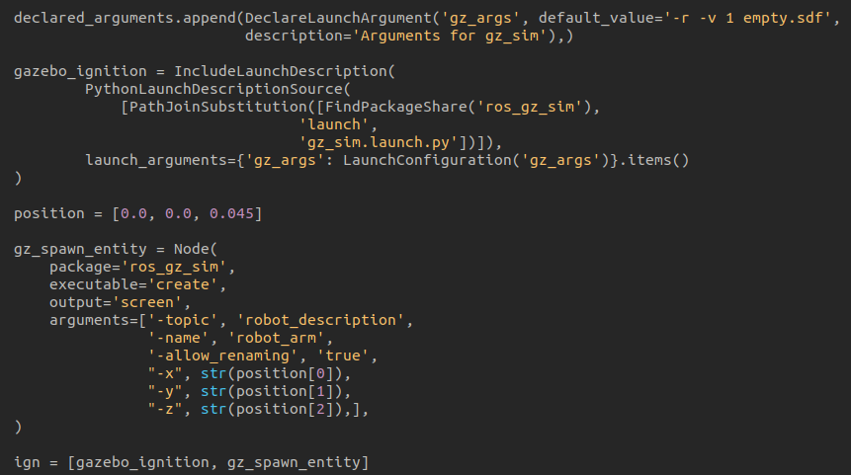
Homework 1
The commands that we have to use to spawn the robot in gazebo are these (let’s notice that the robot will spawn in an empty world in this case):

Slide 15
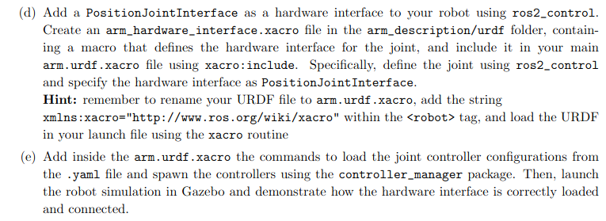
Homework 1
Now, the other points of this part of the HM1 are:
So, we have to add the hardware interfaces for every joint, and we use a xacro macro function to do it quickly, so it will iterate automatically for every joint. Firstly we have to specify that the command interface (like the actuated one) is the position, then we could use the state interface, even for velocity or efforts, to simply retrieve this tipe of data for every joints.

Slide 16
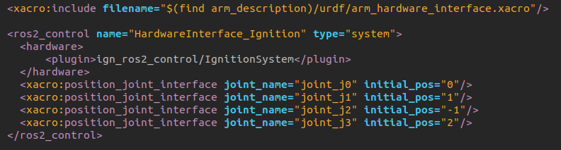
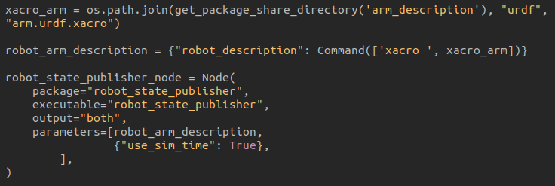
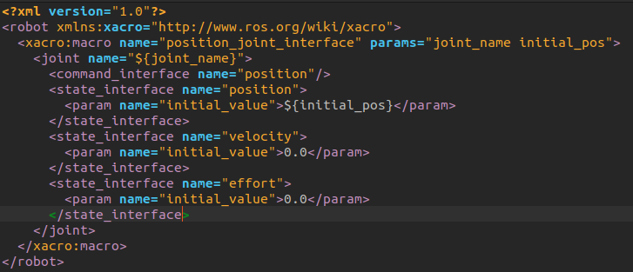
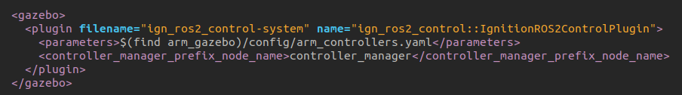
Homework 1
And here it’s shown how it’s done:

Slide 17

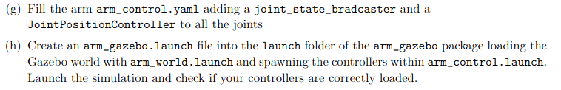
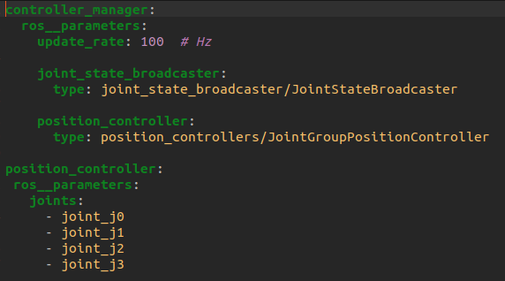
Homework 1
And finally, the last tasks of the second point, are these:
The yaml controllers file is this:

Slide 18
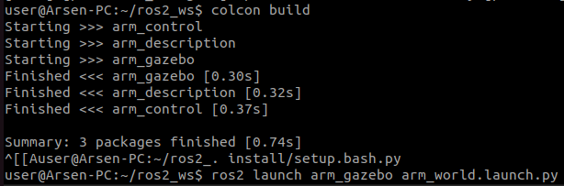
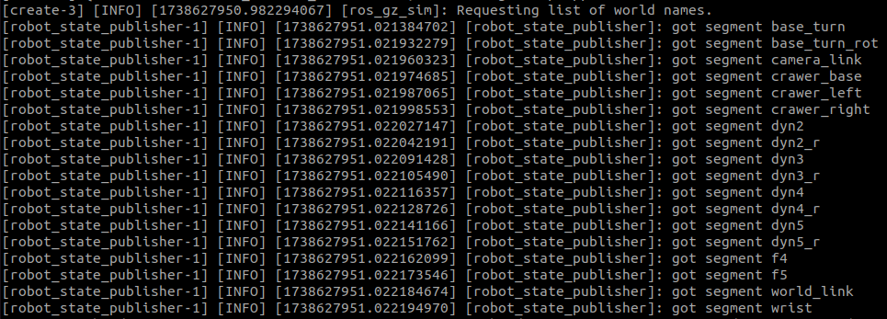
Homework 1
The results of this point are here:

Slide 19
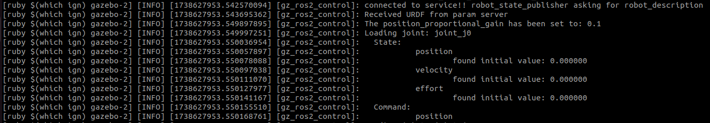
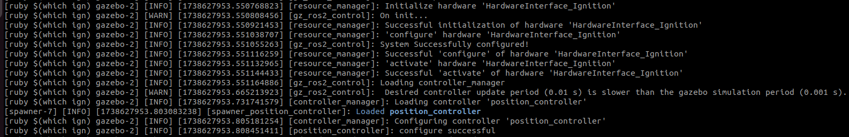
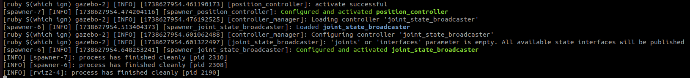
Homework 1

Slide 20
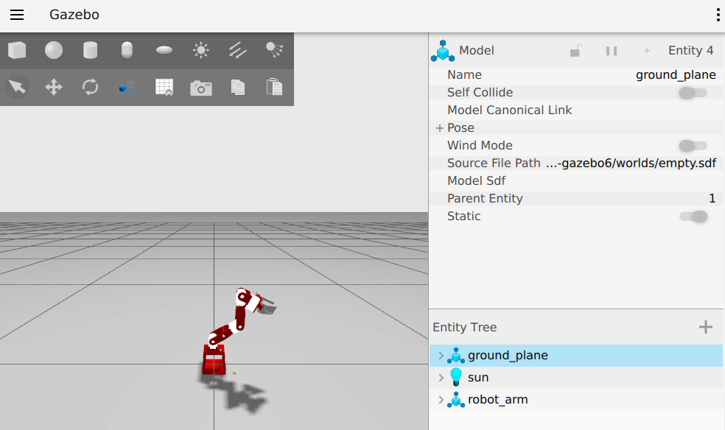
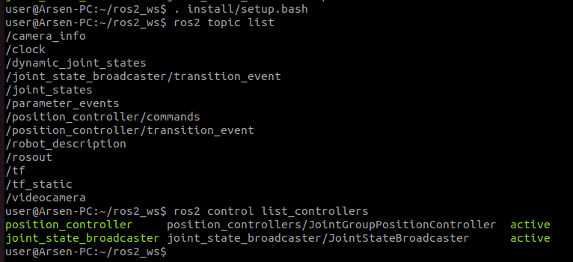
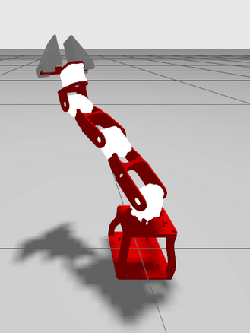
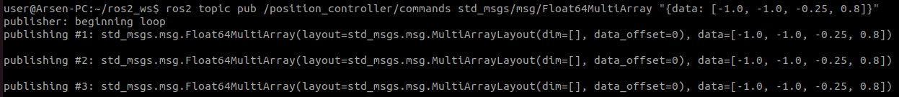
Homework 1

Slide 21
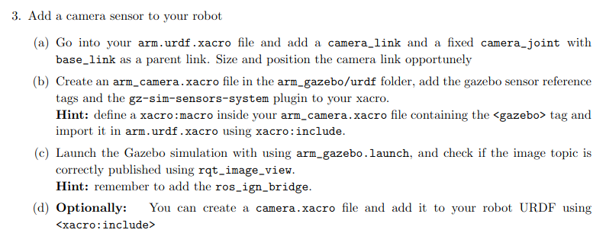
Homework 1
The third point consist basically in adding a camera sensor to the robot and check if the images from it are correctly visualized. In detail, here are the tasks to accomplish:
The hardest thing to do in this case wa to rotate properly the camera frame, so that the view can be visualized in the right orientacion.

Slide 22
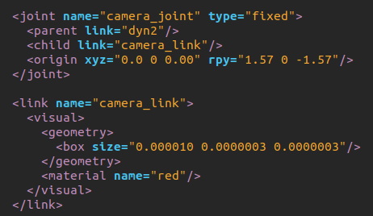
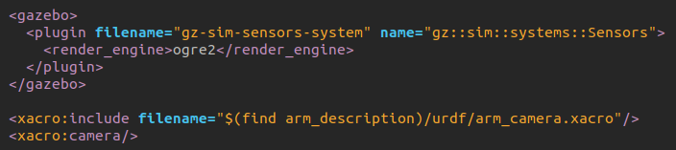
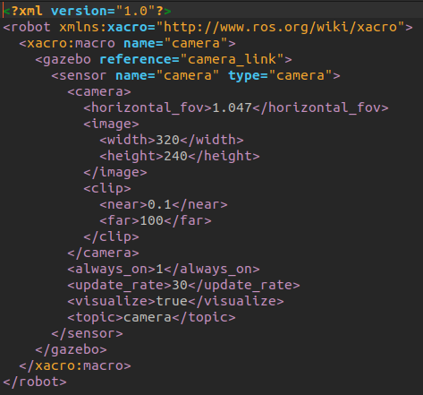
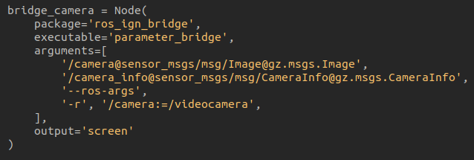
Homework 1
Here are shown the pieces of code that we need to add a camera to out robot, practically, it works just like another link element attached to the robot by a sort of joint (we can notice that the joint is fixed and that for set the orientation we use RPY angles):

Slide 23
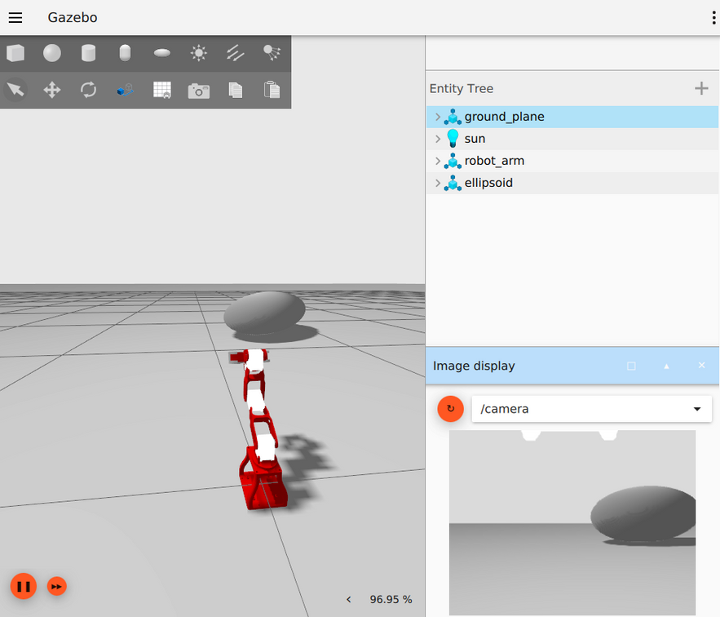
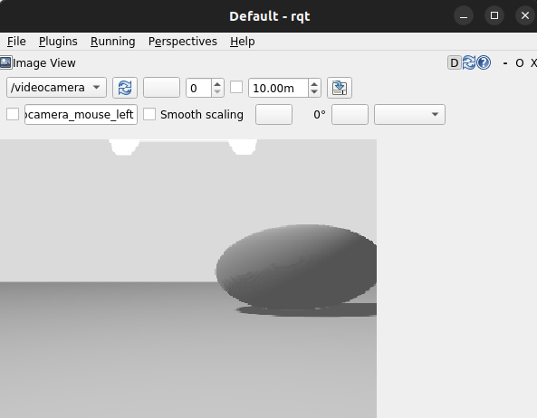
Homework 1
And here instead, are shown the results of what I’ve done in this point:

Slide 24
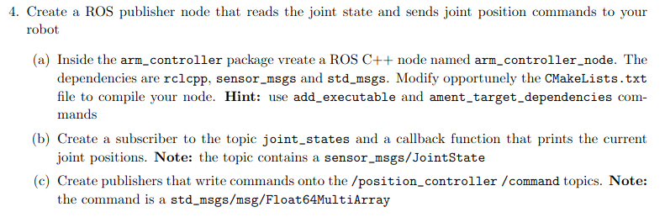
Homework 1
The last point of this homework, asks us to create a ros2 node in c++, which function is to listen the joint state broadcaster, so it would have the information about the current state of the joints, and then print it. But also, another function of this node is to send joint desidered configurations, on the command interface (in position) se we can move the robot without sending manually the commands (like did before). The things to do are those:

Slide 25
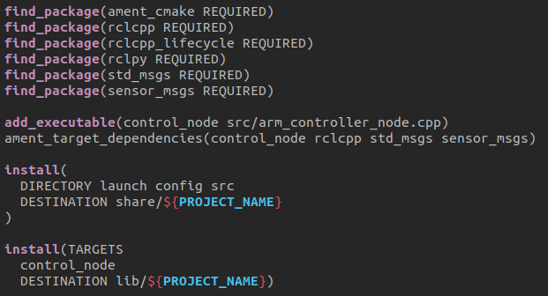
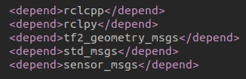
Homework 1
The needed dependencies in the CMakeList.txt file and in the package.xml are shown here:
We can also notice the add executable for our control node and the targeting of the dependencies for it.

Slide 26
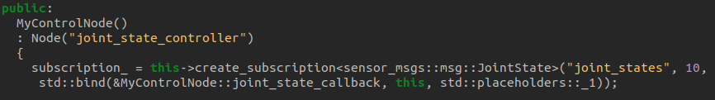
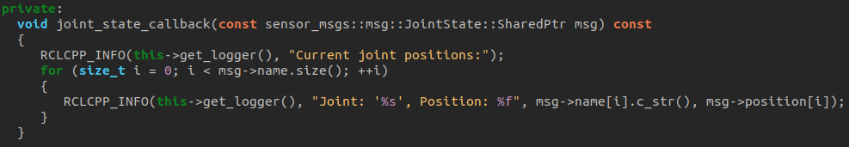
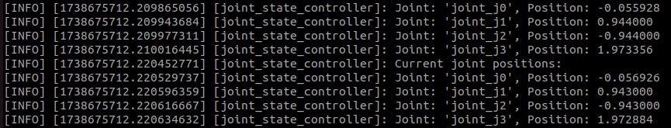
Homework 1
So, like we said, one of the tasks of our control node is to be a listener of the joint state topic and publish with a certain frequency the current state of the joints. Here is the code for the subscriber function, and also an example of the printed output:

Slide 27
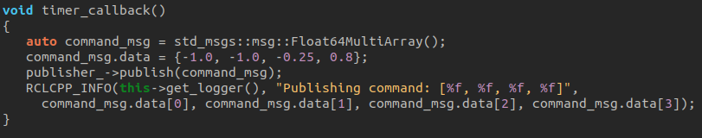
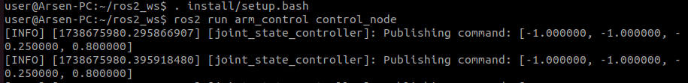
Homework 1
And here is shown how is implemented the last task of the node, so the part of it that publishes the position commands on the appropriate topic, which is being listened by the control part of our project:

Slide 28
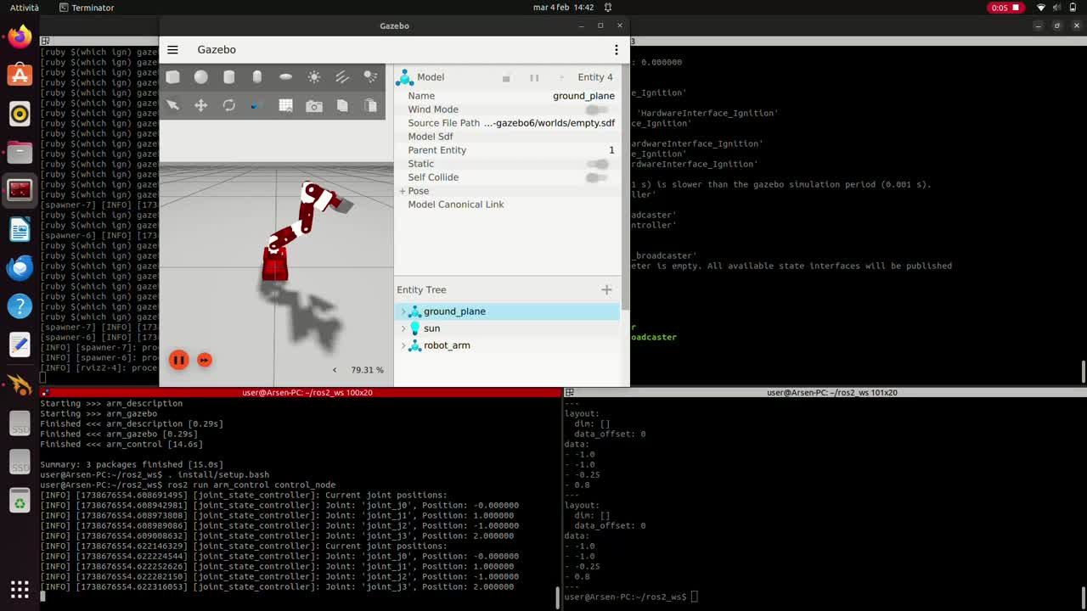
Homework 1
And lastly, of course I want to show the complessively results of the simulation, which consist in moving the manipulator from one configuration to another:

Slide 29
Homework 1
So this ends the presentation of this HM1, I’m happy to see the results and that everything’s working like it should, here I’ll also leave the commands to type in the docker to start the various simulations that I’ve implemented, thanks for the attention:
To start the very first simulation in the Rviz2 environment, you must have the arm_description package and type ros2 launch arm_description display.launch.py;
To start the macro simulation of the robot in Gazebo, also with the controllers and the camera ready, you must have the arm_description, arm_gazebo, and arm_control packages, and type ros2 launch arm_gazebo arm_world.launch.py;
To start the node which is used to retrieve data from the sensors and to send the desired position commands, you must have all the packages specified in the previoous point, and write in the shell ros2 run arm_control control_node, also, to modify the position commands, you need to follow this path arm_control/src/arm_controller_node.cpp, you’ll find the part of code which is used to change the desider configuration.

